Slide 1

SRM INSTITUTE OF SCIENCE AND TECHNOLOGY
SCHOOL OF COMPUTING
18CSP107L – Mini Project
Welcomes You All
‹#›

Slide 2

Student 1 Reg No: RA1811028010076
Batch ID: NWCO76
Guide name and Designation: Dr P Vigneshwaran, Associate Professor
SRM INSTITUTE OF SCIENCE AND TECHNOLOGY
FACULTY OF ENGINEERING AND TECHNOLOGY
DEPARTMENT OF NETWORKING AND COMMUNICATIONS
18CSP108L- MINOR PROJECT
REVIEW NO.6
REVIEW DATE: 26/04/2022
Network Intrusion using a Neural network

Slide 3
Introduction
Networks are vulnerable to today’s techniques of penetration by hackers any attempt by an attacker is seen as an intrusion attempt as any further attacks like privilege escalation will occur only if the network has been intruded.
There are generally two ways of mapping an attack on a network
Passive: Attackers gain access to a network and can monitor or steal sensitive information, but without making any change to the data, leaving it intact.
Active: Attackers not only gain unauthorized access but also modify data, either deleting, encrypting or otherwise harming it.
Some common network attacks are
Distributed Denial of Service (DDoS) attacks
Insider threats
Man in the middle attacks
To prevent this there have been systems called Intrusion Detection system which detects these kinds of attacks and takes action like reporting to the owner of the network

Slide 4
Comparison of Existing Systems
Name of the author | Algorithm used | Dataset used for training/testing | Performance of the Algorithm(Accuracy, F1 score, etc.)
Mrutyunjaya .et.al | Combination of random forest and END(Ensembles of Balanced Nested Dichotomies) | NSL-KDD | Precision:99.9% Recall:99.9% F1:99.7% Acc:99.5%
Kingsly et al | fpMAFIA (custom built) | KDD 99 | Precision:99.9% Recall:99.9% F1:99.7% Acc:99.5%
Reyadh et al | Backpropagation NN with Multi layer perceptron | NSL-KDD | Detection Rate:94.7% Acc:95.3%
Xianwei et al | Voting adaptive algorithm( decision tree, random forest, kNN, DNN),DNN,Multitree | NSL-KDD | Ensemble voting Precision:86.5% Recall:85.2% f1:84.9% Acc :85.21%

Slide 5
Name of the author | Algorithm used | Dataset used for training/testing | Performance of the system (Accuracy, F1 score, etc.)
Tarek et al | Decision Tree | Not mentioned | 79.8%
Kaiyuan et al | SMOTE,CNN,Bi-LSTM | NSL-KDD UNSW-NB15 | NSL-KDD Acc: 83.5% Precision:85.8% Recall:84.4% F1:85.14% UNB Acc:77.16% Precision:82.63% Recall:79.91% F1:81.25%

Slide 6
Observations from Existing Systems
Author Name(s) | Algorithm used | Dataset used for training/testing | Performance of the system (Accuracy, F1 score, etc.)
Chuanlong et al | RNN | NSL-KDD | Detection rate:97.09%
Iftikar et al | SVM,ELM,RF | NSL-KDD | Accuracy: 98.7 %(ELM)
Kehe et al | CNN | NSL-KDD | Detection Rate:68.6 %
Mohammed et al | PSO-FLN | KDD 99 | Acc:99.68%

Slide 7
Problem Identified from Existing System
Mrutyunjaya .et.al[1] used Naives Bayes approach on KKD’99 dataset and is able to get a very high detection rate for their approach but their approach has a lot of false positives
Kingsly .et .al[2] used a grid clustering algorithm for unsupervised anomaly detection . They have used the same KKD’99 dataset and were able to reach decent results but has low performance compared to other characteristics
Reyadh.et .al [3] have used an approach where they reduce the decision time by reducing the samples in the dataset and then apply Decision trees and nearest neighbor . The limitation in their approach is that they are providing wrong prediction for a class of attacks.
Xianwei et al[4] proposed an ensemble learning algorithm and compares it with numerous algorithms. Although their ensemble algorithm has the highest accuracy feature selection process needs to be improved and their work does not describe which features helped them get the results.
Tarek .et.al [5] has used a pattern matching and protocolo analysis (using Decision trees) approach Since the pattern matching approach works using signature detection the disadvantage of the pattern matching approach is that there are many new signatures that are created for novel ID attacks this leads to the pattern matching approach being expensive.

Slide 8
Problem Identified from Existing System
Chuanlong et al has used the RNN algorithm to create an IDS.This method has given them a higher accuracy but has taken a lot of time to detect and contains vanishing gradient which shows that their model may not be able to retrieve long term memory
Iftikar et al compare performance between SV,ELM and RF .They are able to find ELM as the best algorithm performing for large datasets but they are not able to classify specific attacks they only classify normal and intrusive data.
Kehe et al have used a CNN model to create an IDS .Their CNN intrusion detection model performs better that traditional intrusion detection methods.But the detection accuracy is too low and the time required to detect needs to be reduced
Mohammed et al have made a custom algorithm which is based on particle swarm optimization. While their fast learning network is able to provide higher accuracies when the number of hidden layers increase, they have not considered the accuracy of the minority class which is low due to less number of samples of that class.

Slide 9
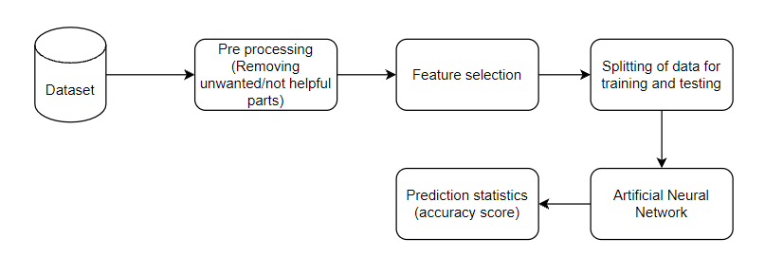
Block diagram of the proposed system

Slide 10
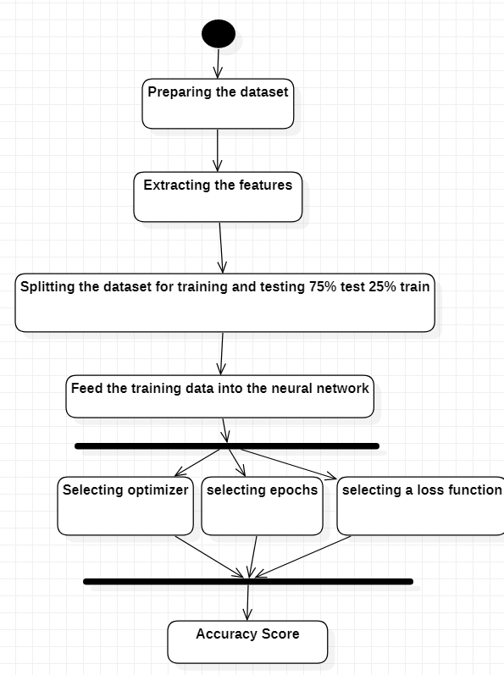
UML diagram (Activity Diagram)

Slide 11
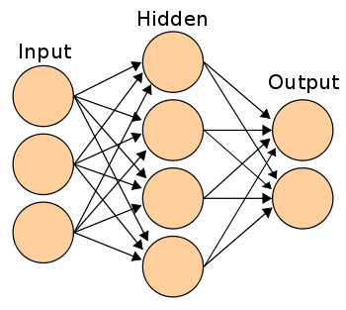
Algorithm used
Artificial neural network algorithm has been used in this work
Our work can contain many types of network attacks which may lead to a multi-class label
ANN’s are good in multi-class classification
ANN’s have three stages while processing

Slide 12

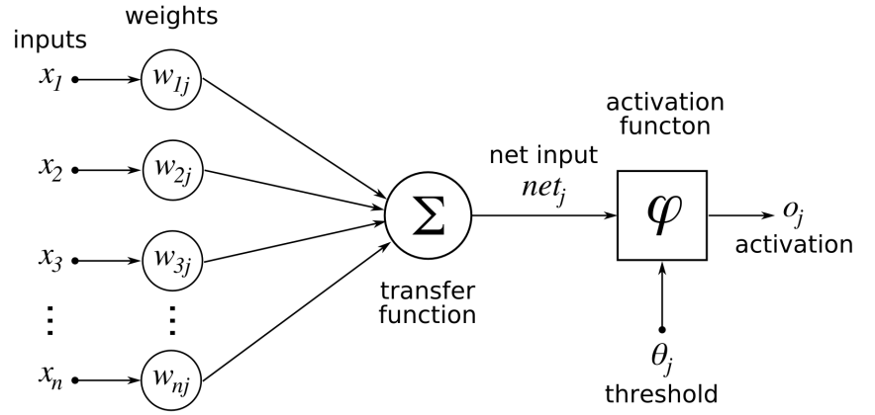
Working settings
Formula :

Slide 13
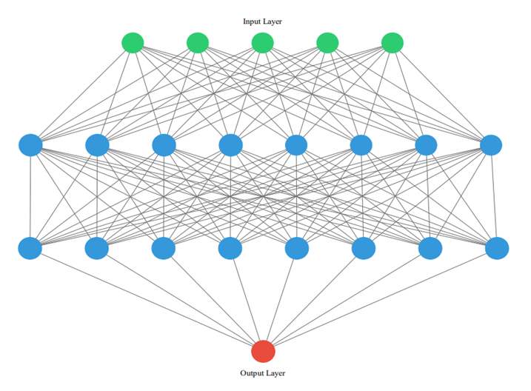

Slide 14
Module Description
Dataset: In our dataset we have 48 features initially which we can use to predict the binary classification . We remove the unhelpful data from dataset using the next steps
Pre Processing: We remove null values from the dataset and replace them with zero. We also remove any string data which may not be of help
We use the two steps below
Standard Scaling: To bring the values of our dataset in a specified range
Label Encoding: To provide labels to string data
Feature Selection: We select features using a method called recursive feature elimination which requires a machine learning algorithm to eliminate features which do not contribute to the prediction
Splitting the data into train and test: We split the data into 70% train and 30% test
Model execution
Computation of performance metric

Slide 15
Model settings
Setting | Option
Optimizer | Adam
Total Neurons | 17
HIdden layers | 2
Output neuron | 1
Epochs | 10
Activation function | ReLu, Sigmoid

Slide 16



Results and Discussion
In this classification we have a supervised learning algorithm which has provided us with the cores below. Often in classification problems supervised algorithms work better than unsupervised ones
We have used performance metrics such as precision, recall and f-measure to see the performance score. All of these metric have a score between 0 and 1 being the highest.

Slide 17
TABLE represents the confusion matrix for different thresholds
Threshold | True Negative | False Positive | False Negative | True Positive
0.6 | 6184 | 1431 | 87 | 9302
0.7 | 6890 | 1355 | 161 | 9228
0.8 | 7192 | 1053 | 1339 | 8050
0.9 | 8245 | 0 | 9389 | 0

Slide 18
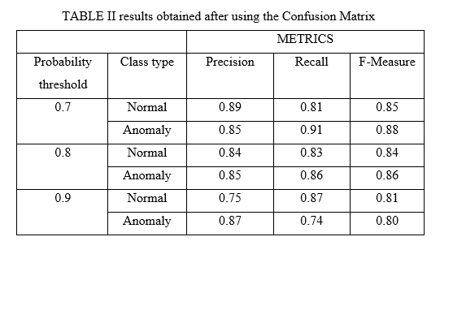

Slide 19
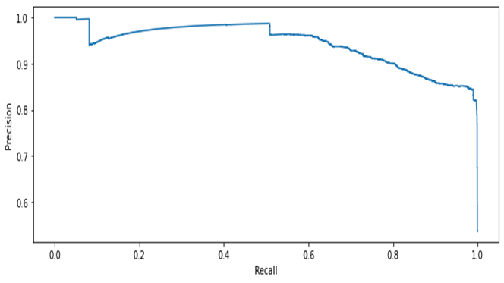
Precision-Recall Curve

Slide 20
References
Panda, Mrutyunjaya, Ajith Abraham, and Manas Ranjan Patra. "A hybrid intelligent approach for network intrusion detection." Procedia Engineering 30 (2012): 1-9.
Leung, Kingsly, and Christopher Leckie. "Unsupervised anomaly detection in network intrusion detection using clusters." Proceedings of the Twenty-eighth Australasian conference on Computer Science-Volume 38. 2005.
Antal, Margit, and Elöd Egyed-Zsigmond. "Intrusion detection using mouse dynamics." IET Biometrics 8.5 (2019): 285-294.
Gao, Xianwei, et al. "An adaptive ensemble machine learning model for intrusion detection." IEEE Access 7 (2019): 82512-82521.
Abbes, Tarek, Adel Bouhoula, and Michaël Rusinowitch. "Protocol analysis in intrusion detection using decision tree." International Conference on Information Technology: Coding and Computing, 2004. Proceedings. ITCC 2004.. Vol. 1. IEEE, 2004

Slide 21
References
Yin, Chuanlong, et al. "A deep learning approach for intrusion detection using recurrent neural networks." Ieee Access 5 (2017): 21954-21961.
Ahmad, Iftikhar, et al. "Performance comparison of support vector machine, random forest, and extreme learning machine for intrusion detection." IEEE access 6 (2018): 33789-33795.
Wu, Kehe, Zuge Chen, and Wei Li. "A novel intrusion detection model for a massive network using convolutional neural networks." Ieee Access 6 (2018): 50850-50859.
Ali, Mohammed Hasan, et al. "A new intrusion detection system based on fast learning network and particle swarm optimization." IEEE Access 6 (2018): 20255-20261.

Slide 22
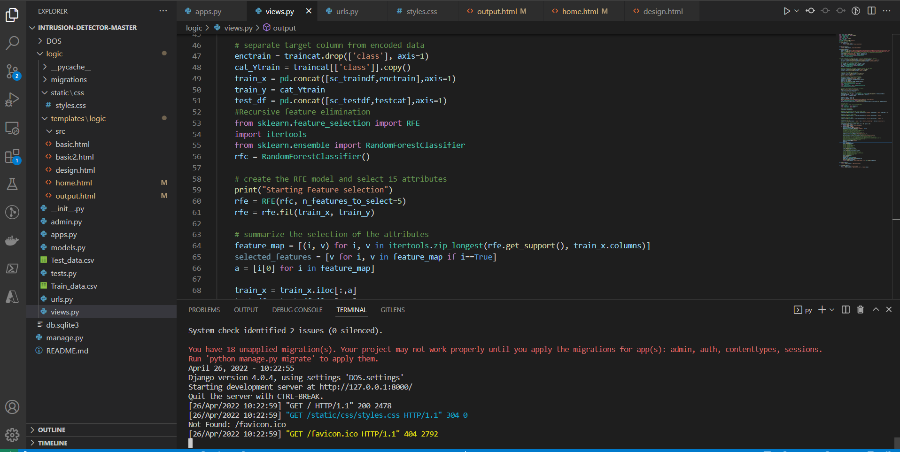

Slide 23
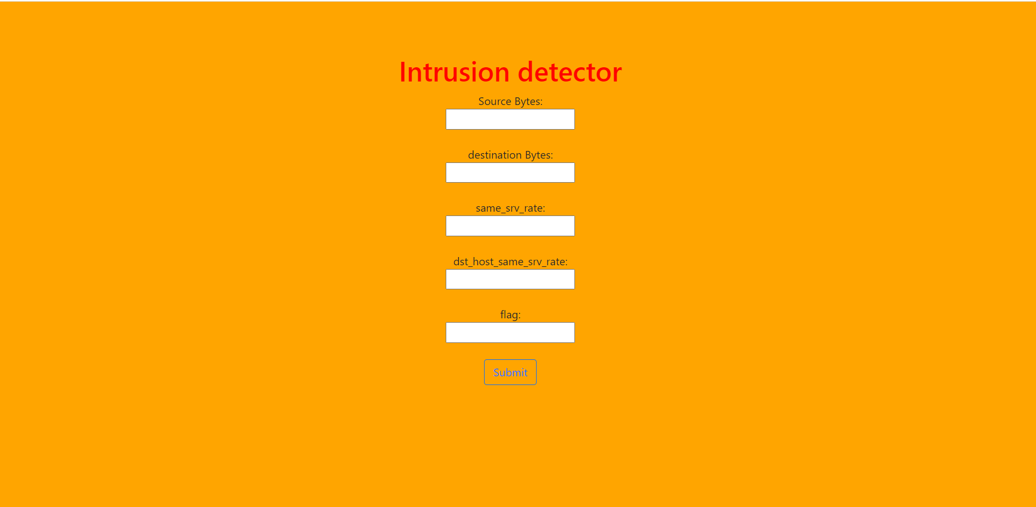
Appendix

Slide 24
Thank You

